Slide 1

Working in software teams
Data Sciences Institute
University of Toronto
Simeon Wong
Notes:
Hi everyone, welcome back to our 3rd week of Data Science Fundamentals

Slide 2
Asking questions
Zoom chat during class
Feel free to post and answer questions at any time
I will pause for questions occasionally, and review questions from the chat
Pre- / Post-class office hours with Tong
Email
simeonm.wong@mail.utoronto.ca
tong.su@mail.utoronto.ca

Slide 3
Daily scrum
Write in the chat:
How you’ll use one thing you’ve learned so far
One thing you’re struggling with / wish the course addressed

Slide 4
How to write robust software in a team that we, our colleagues, and the public can trust and use with confidence.

Slide 5
Previously at the DSI…
Testing code
Write code with testing in mind
pytest and GitHub Actions for automated testing
Python packages
Python code is usually distributed as packages on PyPI
Use setuptools to describe dependencies
Uploading and installing packages from GitHub using pip

Slide 6
Course overview
Configuration files & Environment variables
Using and writing Application Programming Interfaces (APIs)
Handling errors
Testing software
Building Python packages
Working in software teams using GitHub features

Slide 7
Today’s learning objectives
I can track and manage software projects using GitHub
I can ensure code is reviewed and tested using Pull Requests
I know the principles of software project governance

Slide 8
Why Git?
Review
Scenario: Alex is a developer for a business-intelligence dashboard project.
Alex’s current big project is upgrading a financials chart on the dashboard home page
Halfway through, Alex’s colleague Jordan publishes a bug-fix on one of the analysis functions Sam uses for his chart
Alex needs to integrate the updated analysis function into his work before shipping his upgraded chart to ensure it is correct.

Slide 9
Git: Track changes for software
Review
Addresses unique challenges with working on software collaboratively
Tracks changes to code over time
Backup of your work
Revert to older snapshots / point-in-time
Merge changes from different features developed simultaneously

Slide 10
Git commands
Review
Setup
git init
git clone
Getting info
git status
git log
Making edits
git add
git commit
Incorporating changes
git pull
git merge
Navigating through branches and commits
git checkout
git switch

Slide 11
Alex’s new feature
Alex starts working on NewChart
Jordan starts working on BugFix
Jordan ships BugFix
Alex integrates BugFix
Alex keeps working on NewChart
Alex ships NewChart
Review
BugFix
git branch BugFix
git commit
git merge BugFix
Release
git branch NewChart
git merge Release
git merge NewChart
git commit
git commit
git commit
git commit
git commit
NewChart

Slide 12
Why software project management?
Working in software teams
Scenario: Alex is a developer for a business-intelligence dashboard and is upgrading a financials chart on the dashboard home page
Alex wants to gather ideas and feedback:
How the chart should look
How to make the analysis engine the most efficient
Alex needs a place to track major discussion points on this feature

Slide 13
GitHub
Working in software teams
Centralized hosting for Git repositories
Project management features
Issues
Description of proposed or requested changes: update, features, bug-fixes, etc..
Can associated one or more pull-requests (proposed code changes)
Discussion thread
Projects
Linked to GitHub Issues
View Issues in tabular / Gantt chart view

Slide 14
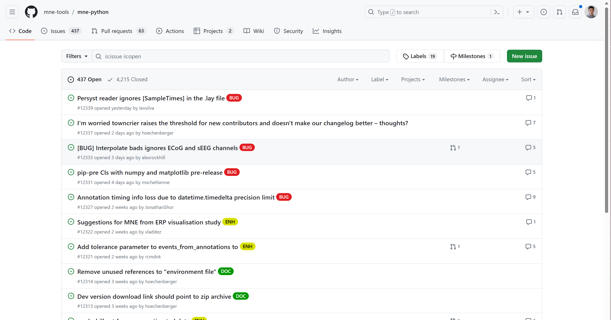
GitHub Issues tracks proposed changes
Working in software teams

Slide 15
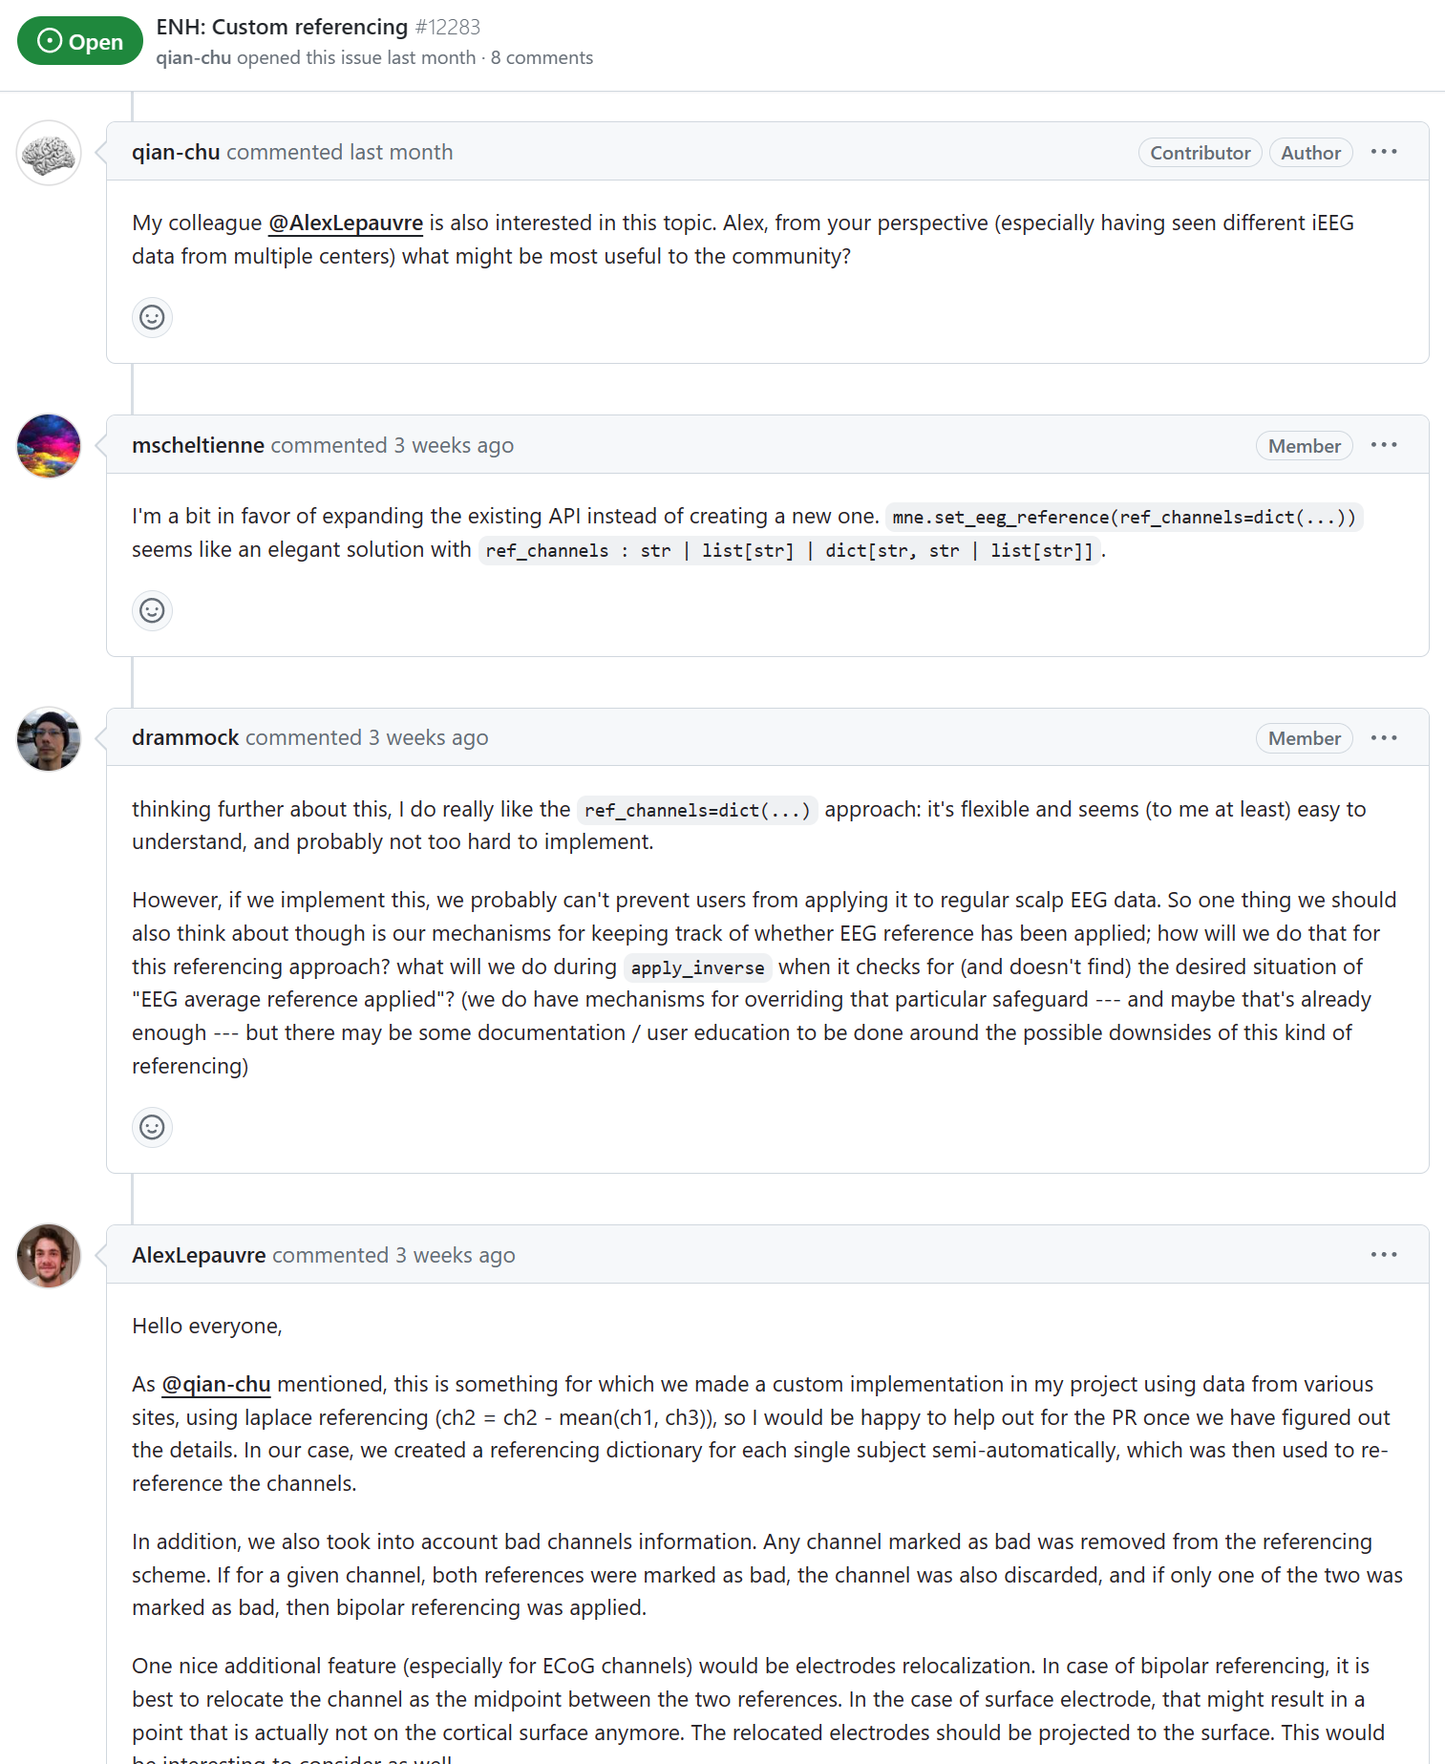
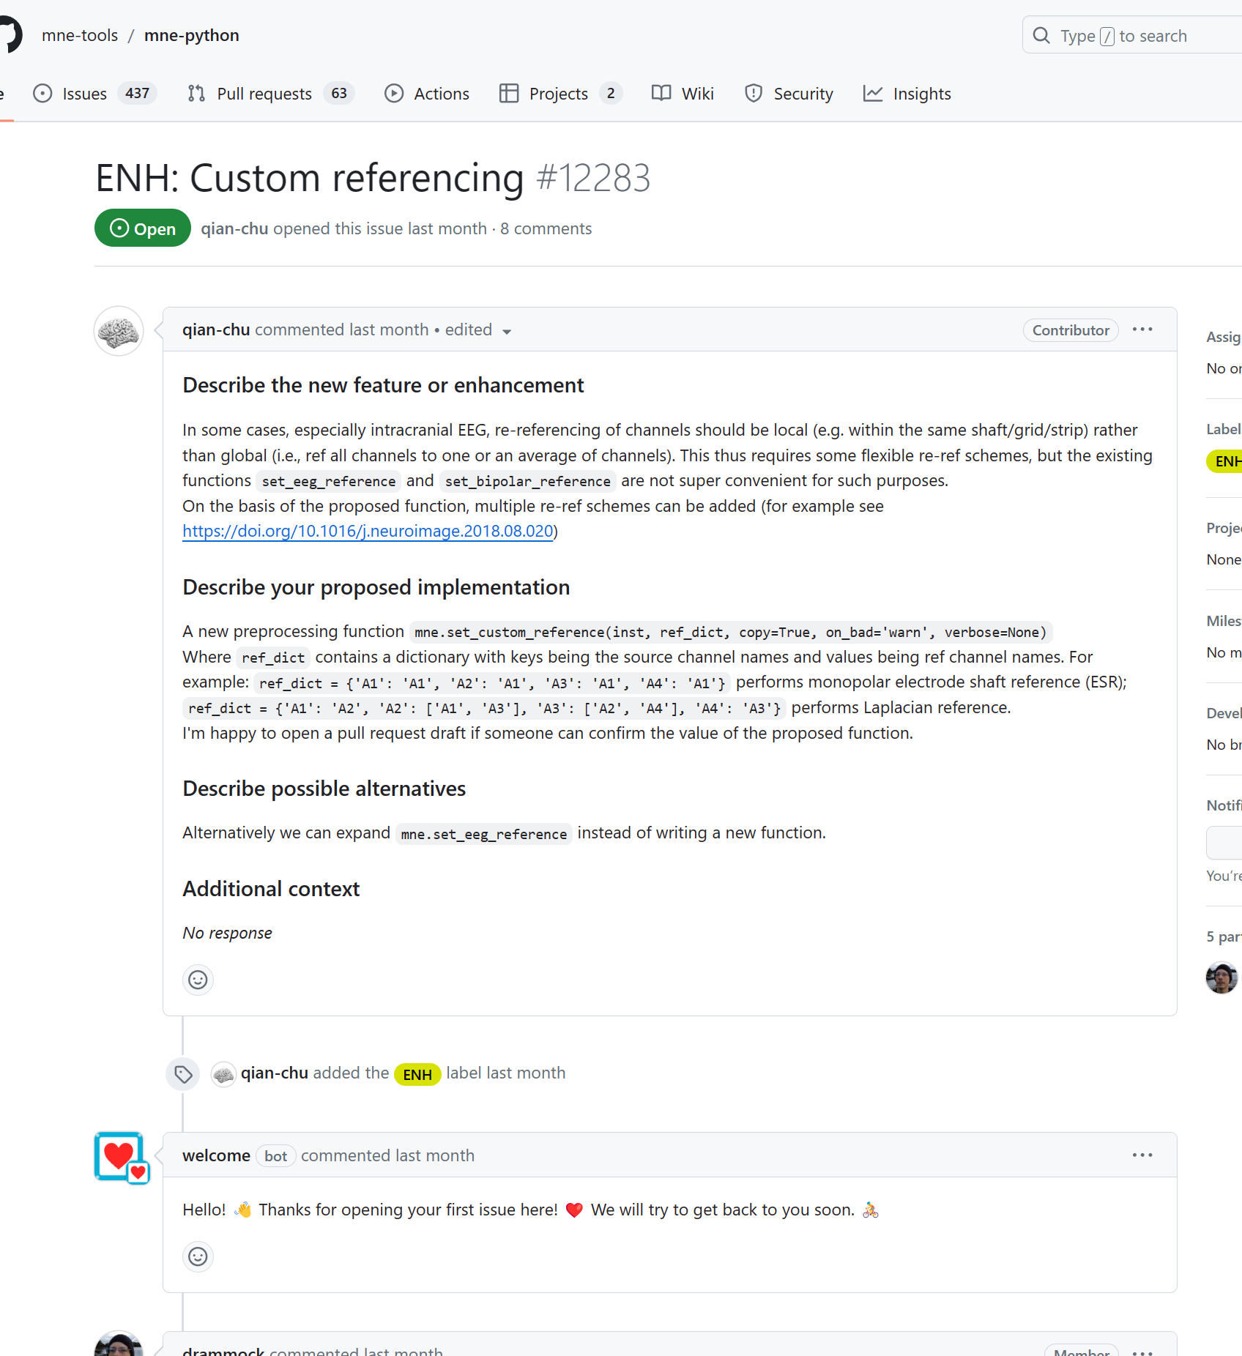
GitHub Issues allows for discussion
Working in software teams

Slide 16
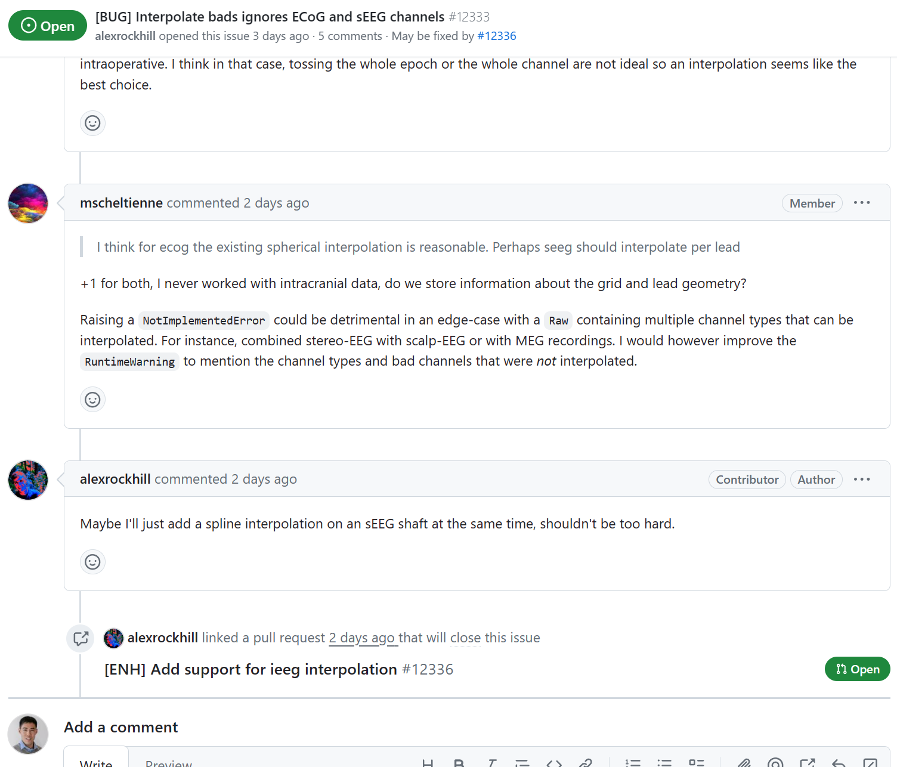
GitHub Issues + Pull Requests
Working in software teams

Slide 17
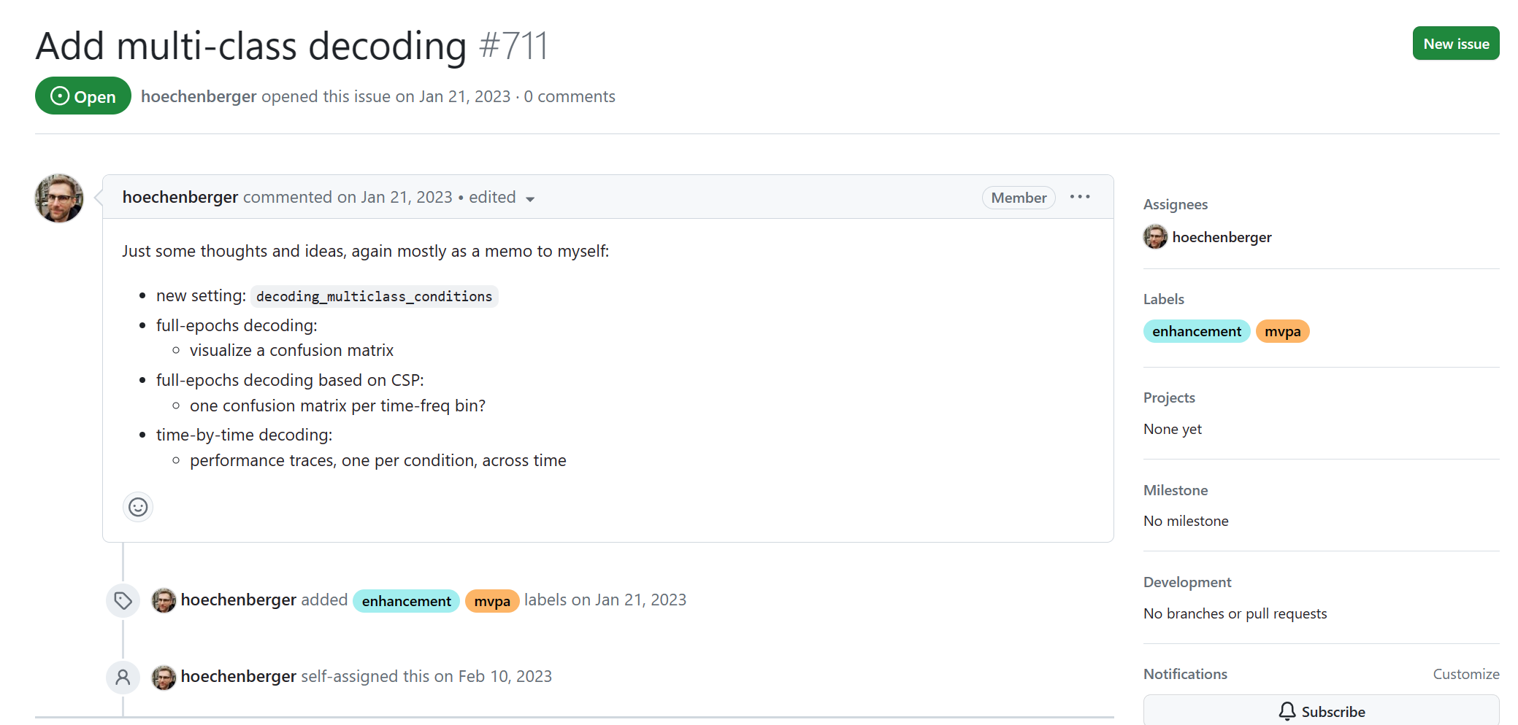
GitHub Issues: Assignees

Slide 18
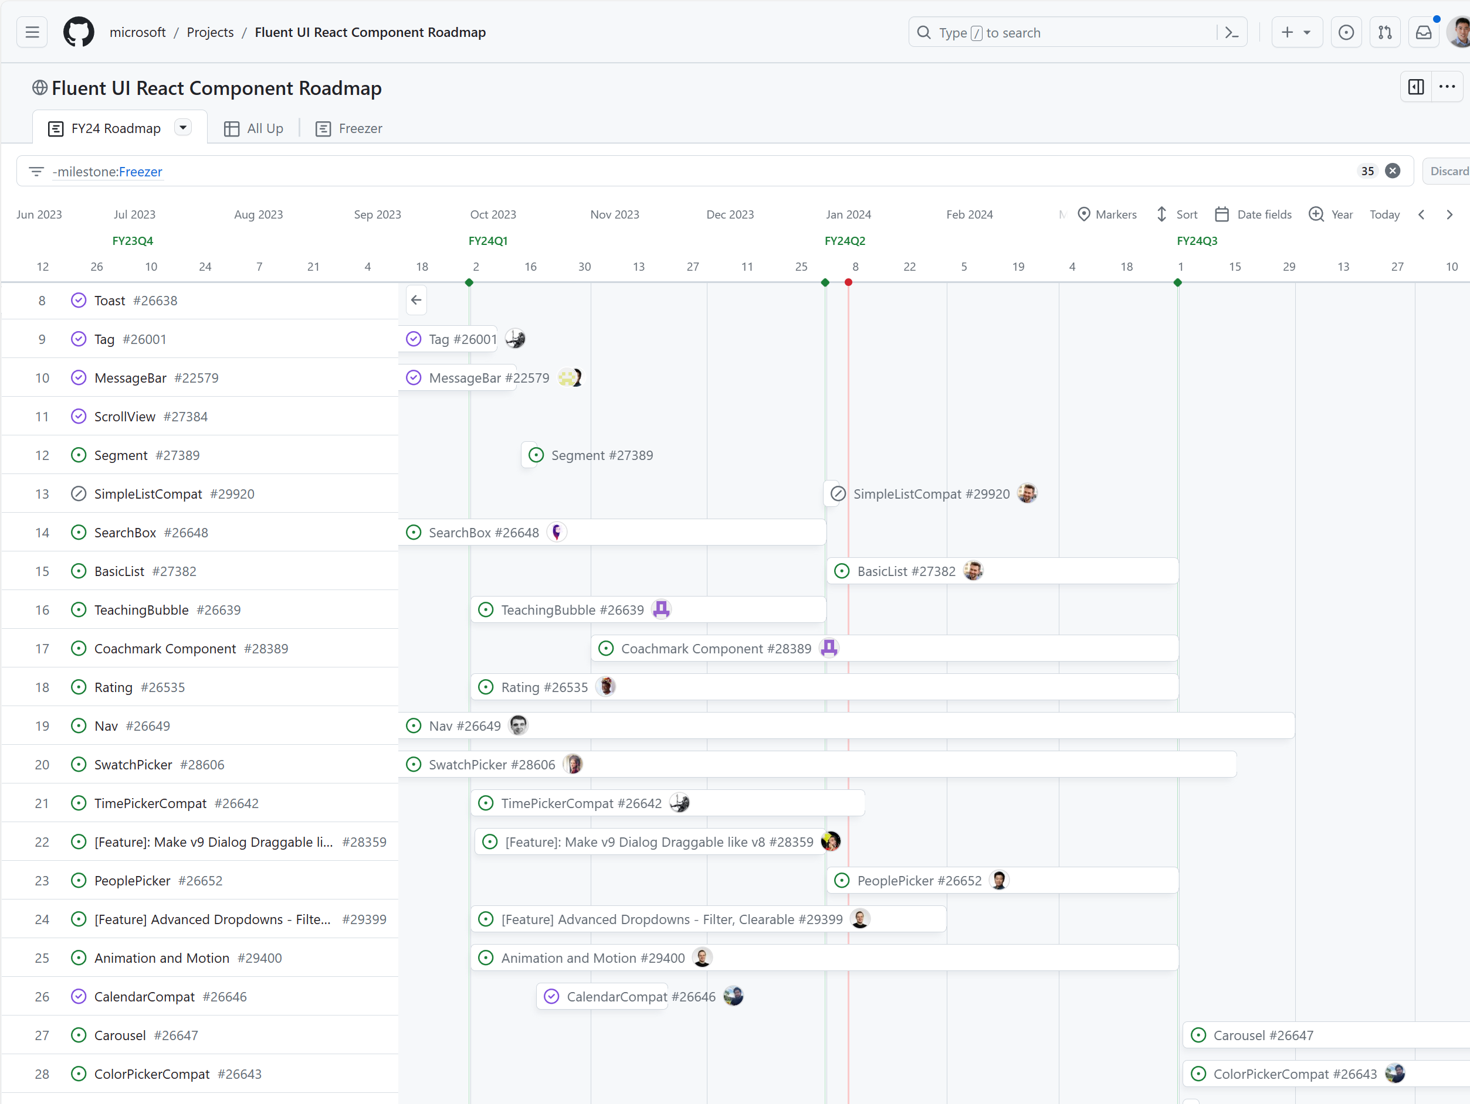
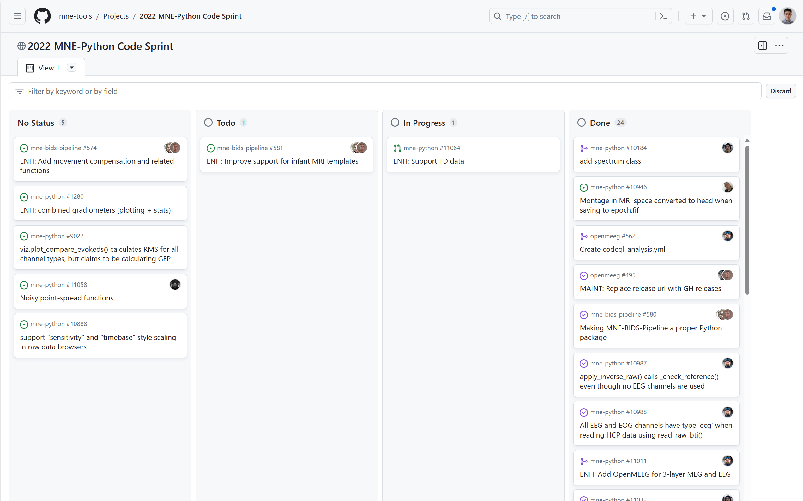
GitHub Projects
Working in software teams

Slide 19
Why software project management?
Working in software teams
Scenario: Alex is a developer for a business-intelligence dashboard project.
Alex’s finishes his big project: upgrading a financials chart
Avery, the engineering manager wants to make sure:
Alex’s feature has been peer-reviewed
The new charting code integrates well into the dashboard
Alex wants to make sure his colleagues can understand how to use his code

Slide 20
GitHub
Working in software teams
Continuous Integration
Alex’s code is automatically tested with pytest on GitHub actions
Code review and approvals
Alex can request a colleague to peer review his code and make comments overall, or even line-by-line
Granular read/write access controls
Pull requests on the main repository can have requirements
e.g. must be approved by one or more colleagues, must pass all unit tests

Slide 21
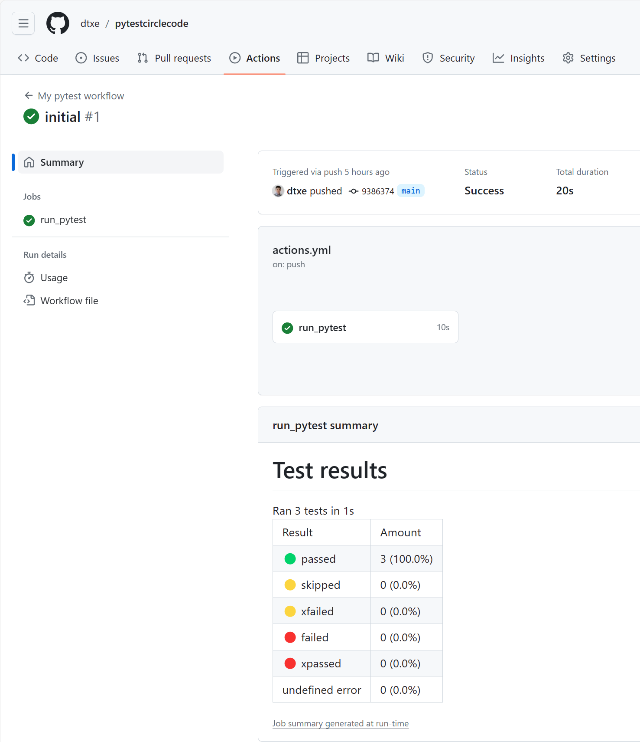
Continuous integration code testing
Working in software teams

Slide 22
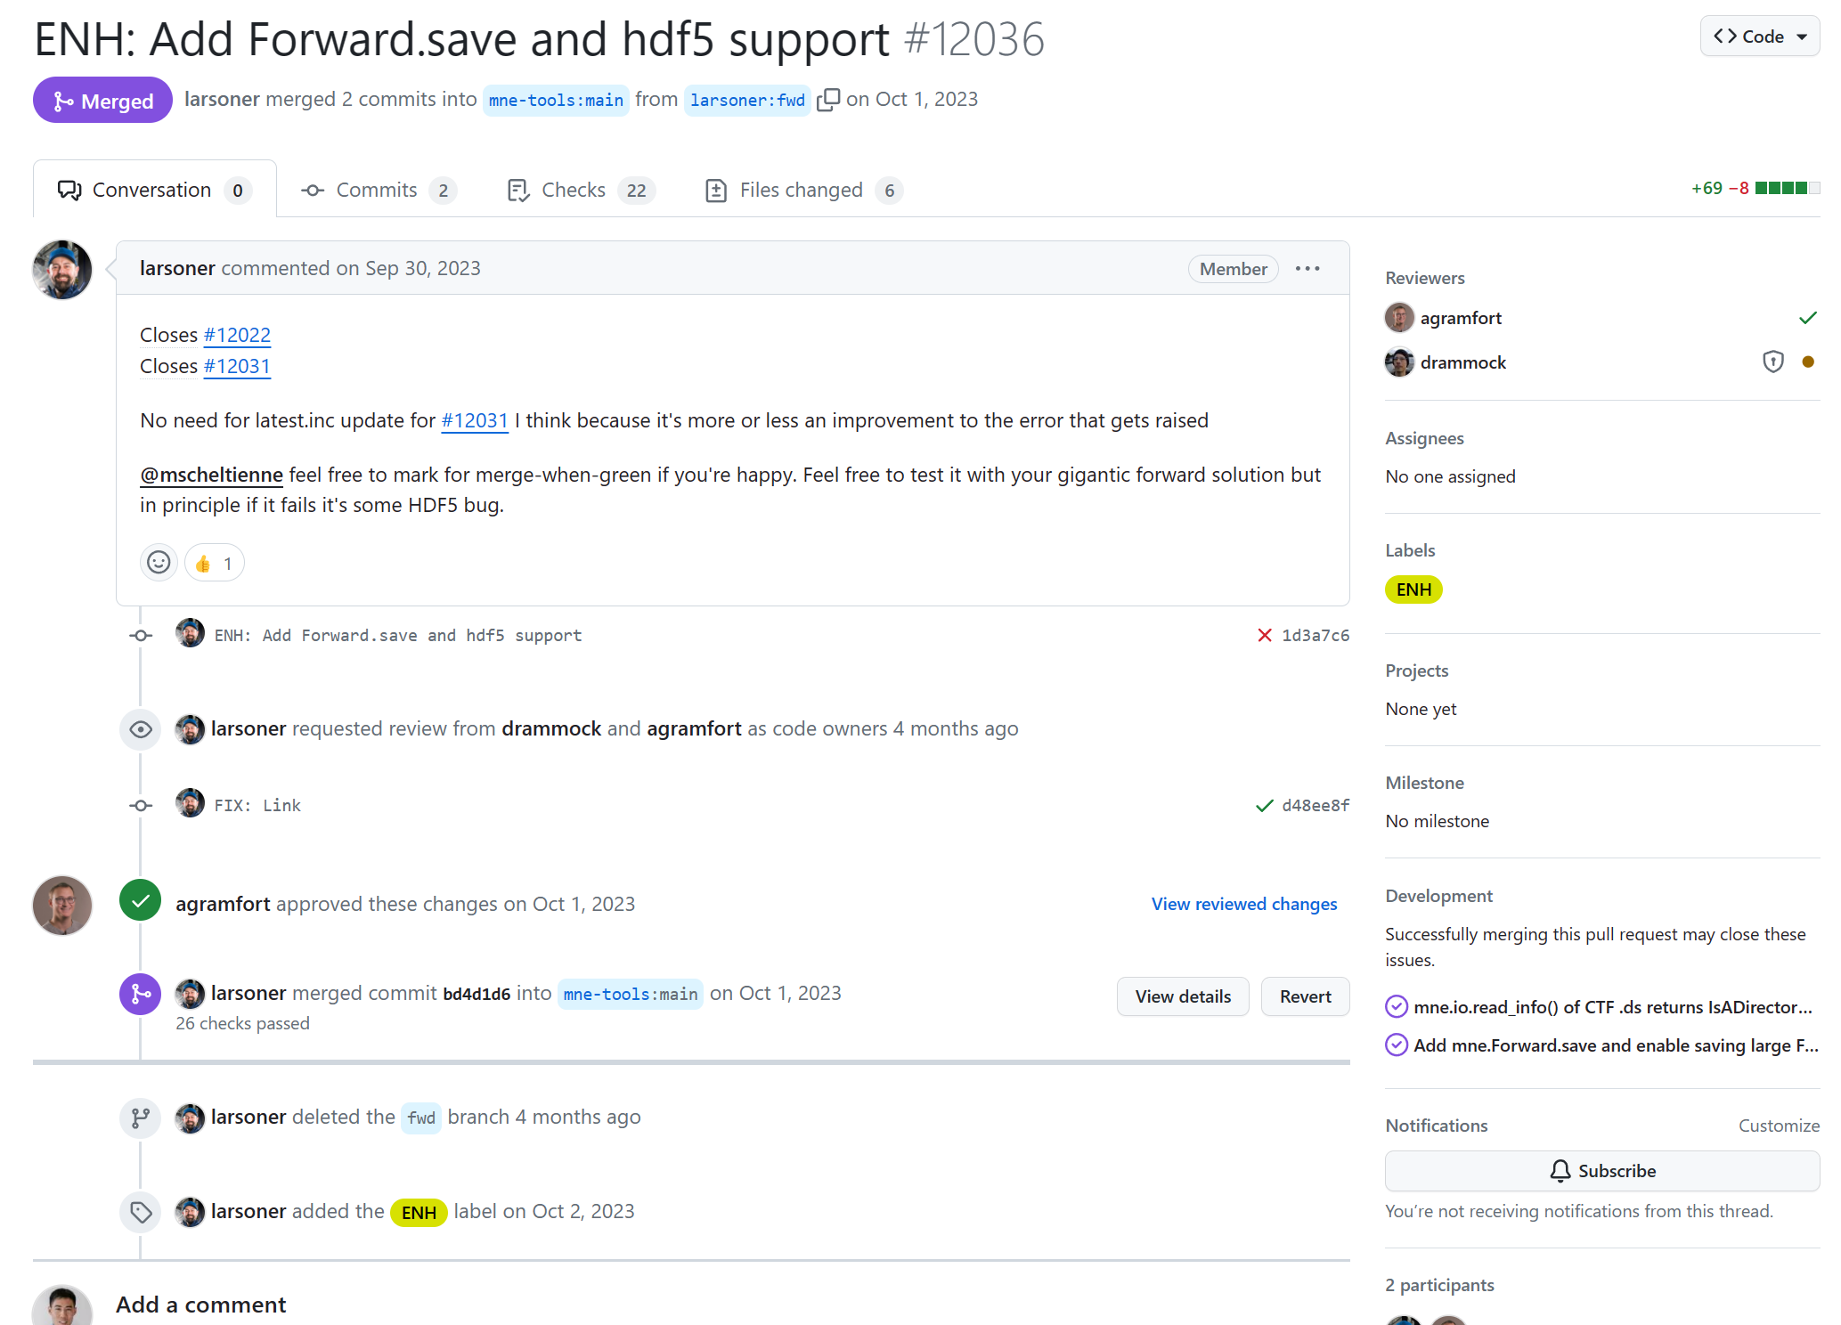
Assigned reviewers and approvers
Working in software teams

Slide 23
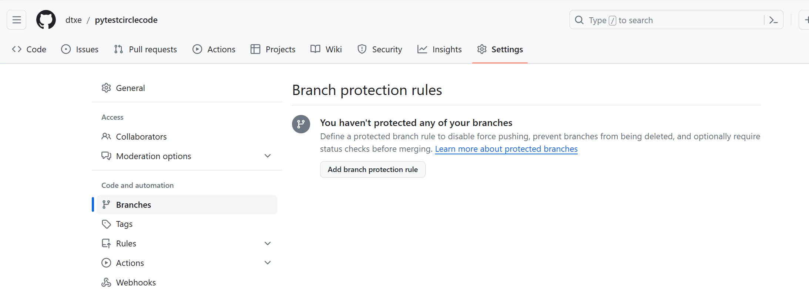
Branch protection rules
Working in software teams
Repository settings > Branches > Branch protection rules

Slide 24
Using GitHub features wisely
Working in software teams
GitHub features are part of a comprehensive code quality strategy
Recall from code testing: Balance between impact/risk and engineering effort
Don’t overburden your contributors and teammates with hoops to jump through if they don’t contribute meaningfully to code quality

Slide 25
Other software project tools
Working in software teams
Code repositories
Atlassian Bitbucket
GitLab
AWS CodeCommit
Azure Repos
Google Cloud Source
Self-hosted over SSH / WebDAV
Project tools
Atlassian Jira
GitLab
Redmine
ClickUp
Monday.com
Asana

Slide 26
What questions do we have?

Slide 27
What makes up a project?
Project governance
A dataset being used by several research projects?
raw data, programs used to tidy the data, tidied data, text files describing license and provenance
A set of annual reports written for an NGO?
jupyter notebooks, copies of html and pdf versions of the report, a text file containing links to datasets used in the report (which can’t be store don Github since they contain personal identifying information)
A software library providing an interactive glossary of data science terms in both Python and R?
files needed to create a package, a Markdown full of terms and definitions, a Makefile with targets to check cross references, etc

Slide 28
What makes up a project?
Project governance
What people have meetings about
Governance: If the same group needs to get together on a regular basis to talk about something, that something probably deserves its own repository
Continuity: And if the list of people changes slowly over time but the meetings continue, that’s an even stronger sign

Slide 29
Copyright licenses
Project governance
A license dictates how project materials can be used and redistributed
Can affect the willingness of contributors
The choice of license is crucial to the project’s long-term sustainability
Consider contributors’ contractual obligations
e.g. students and faculty may have a copyright on the research work they produce, but university staff members may not.
Including an explicit license avoids legal messiness and should be chosen early on
Generally, licenses do not apply retroactively

Slide 30
Copyright licenses
Project governance
Do we want to license the work at all?
Is the content we are licensing source code?
Do we require people distributing derivative works to also distribute their code?
Do we want to address patent rights?
Is our license compatible with the licenses of the software we depend on?
Do our institutions have any policies that may overrule our choices?
Are there any copyright experts within our institution who can assist us?

Slide 31
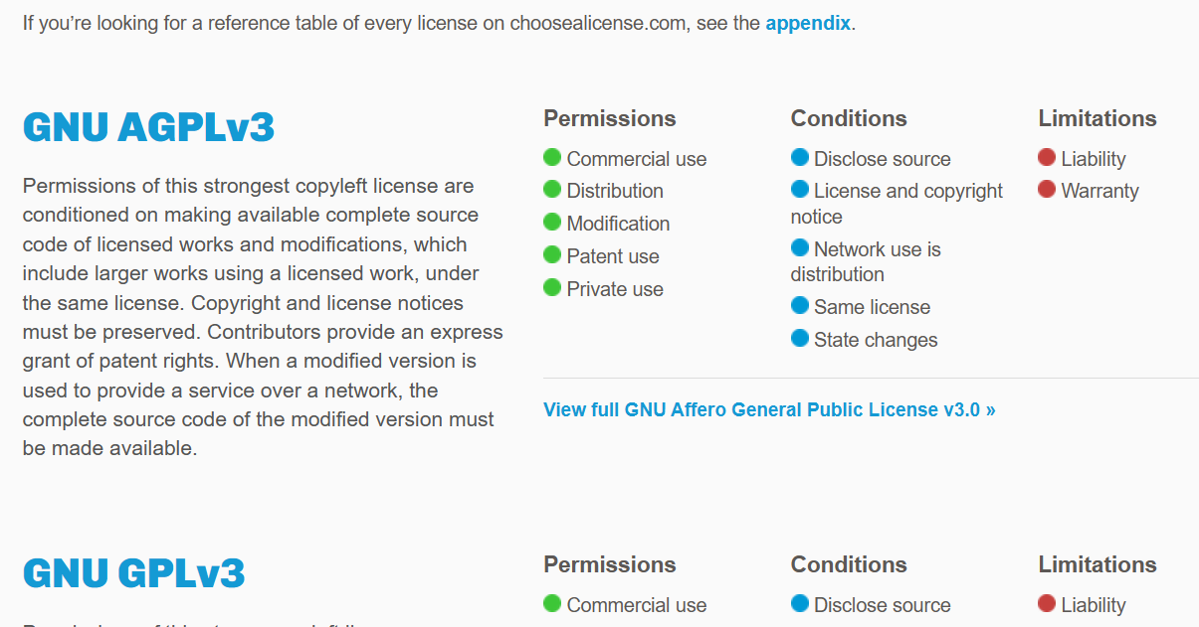
Copyright licenses
Project governance
Great summary here:
https://choosealicense.com/licenses/

Slide 32
The Code of Conduct
Project governance
Promotes fairness within a group
Ensures all members that this project takes inclusion seriously
Ensures that everyone knows what the rules are
Prevents anyone who misbehaves from pretending that they didn’t know what the did was unacceptable
Often listed in a file named CONDUCT.md in project directory.
Example: https://www.contributor-covenant.org/

Slide 33
Decision making
Project governance
Every team has a power structure: formal (accountable) or informal (unaccountable).
Importance of explicit governance in groups larger than six people.
Objective: Establish who makes decisions and how to reach consensus.

Slide 34
Decision making: Martha’s rules
Project governance
Anyone who wants to sponsor a proposal must file one at least 24 hours in advance. It must include:
a one-line summary
the full text of the proposal
any required background information
pros and cons
possible alternatives
A quorum is established in a meeting if half or more of voting members are present
Once a person has sponsored a proposal, they are responsible. The group may not discuss it unless the sponsor is present

Slide 35
Decision making: Martha’s rules
Project governance
After the sponsor presents the proposal, cast a sense vote:
Who likes the proposal?
Who can live with it?
Who is uncomfortable with it?
If everyone likes or can live with it, it passes with no further discussion.
If most of the group is uncomfortable, it is sent back to the sponsor for further work. (The sponsor can decide to drop it)
If some members are uncomfortable, a time is set to discuss, moderated by the meeting moderator.
After 10 minutes or so, the moderator calls a yes or no vote.
If the majority is yes, it passes.
Otherwise, it is returned to sponsor for further work.

Slide 36
Decision making: meeting tips
Project governance
Decide if there actually needs to be a meeting.
Write an agenda.
Include timings in the agenda.
Prioritize.
Make one person responsible for keeping things moving.
Require politeness.
No interruptions.
No distractions.
Take minutes.
End early.

Slide 37
Document everything!
Project governance
Make sure your project description, licenses, code of conduct, decision making structures, meeting details are discoverable for newcomers!

Slide 38
What questions do we have?

Slide 39
How to write robust software in a team that we, our colleagues, and the public can trust and use with confidence.

Slide 40
Building software summary
Track your changes and work collaboratively in Git
Use configuration files
Handle and raise errors with meaningful messages
Document, test, and package your work for others to use
Go forth and build great software! 💪

